Slide 1
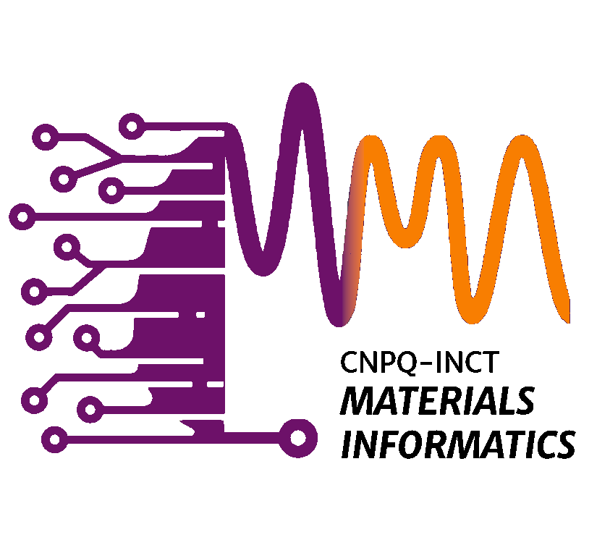

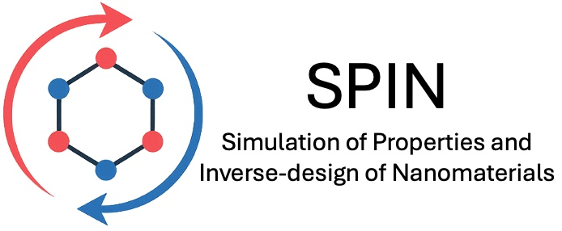


Quantum materials: A new chapter in magnetism
Carlos Mera Acosta
Centro de Ciências Naturais e Humanas
Universidade Federal do ABC

Slide 2
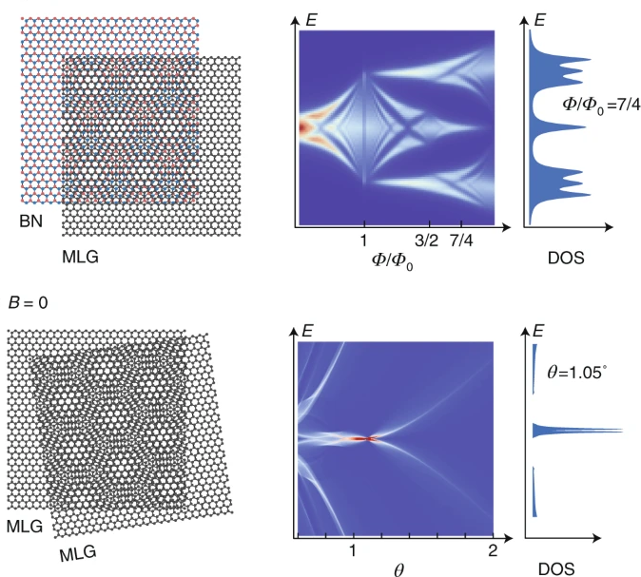
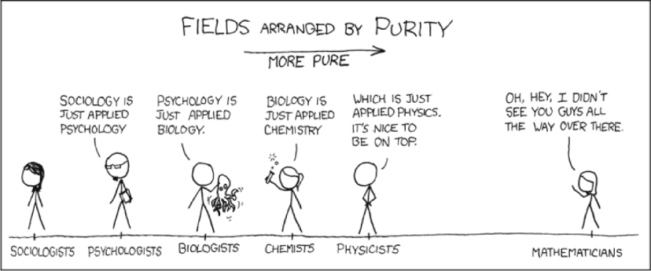
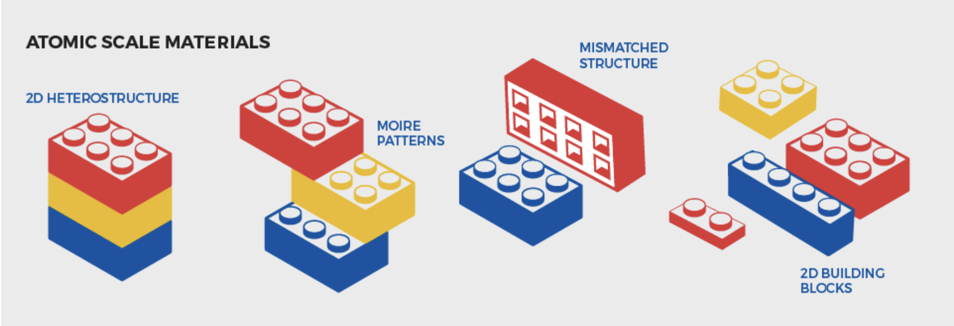
Quantum materials: when “more is different” …
“…the behavior of large and complex aggregates of elementary particles, it turns out, is not to be understood in terms of a simple extrapolation of the properties of a few particles. Instead, at each level of complexity entirely new properties appear…” Philip Anderson (1972)
Emergent phenomena
Nature 600 (2021)

Slide 3
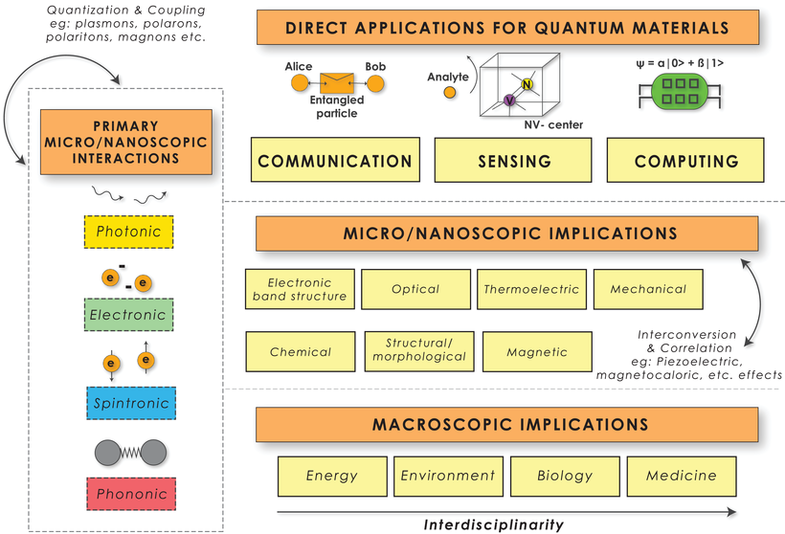
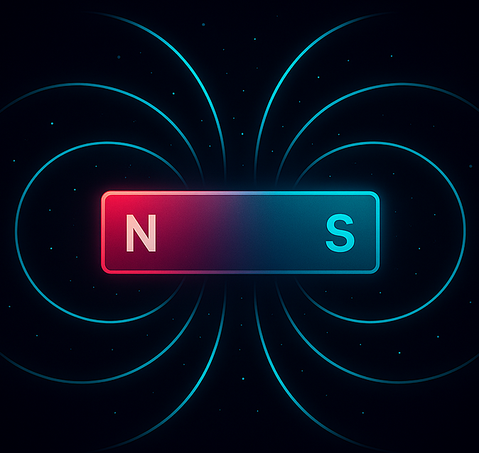
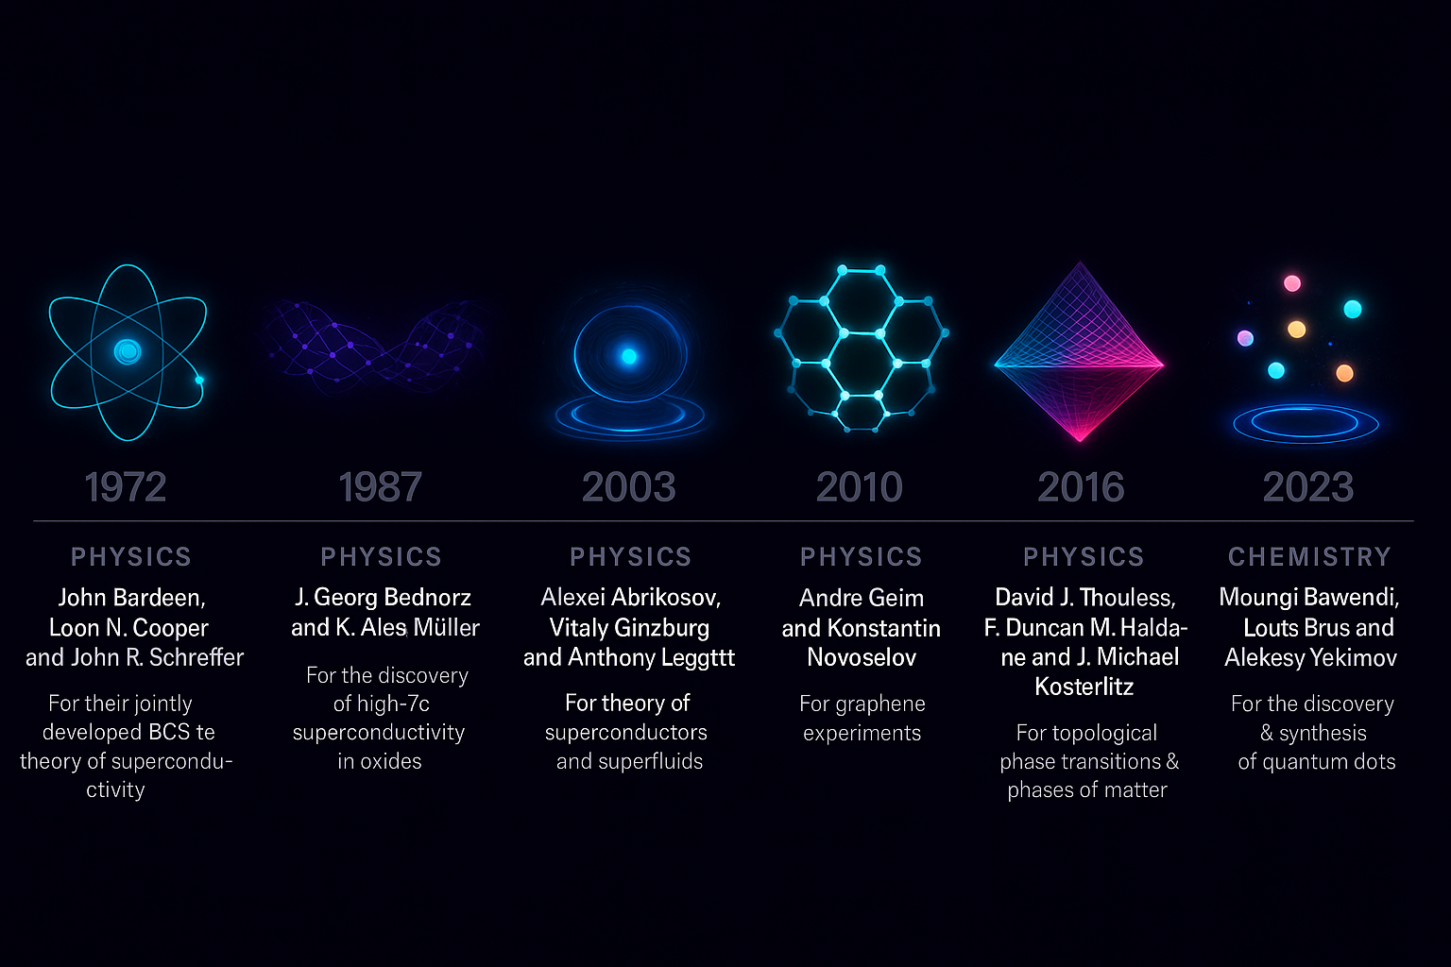
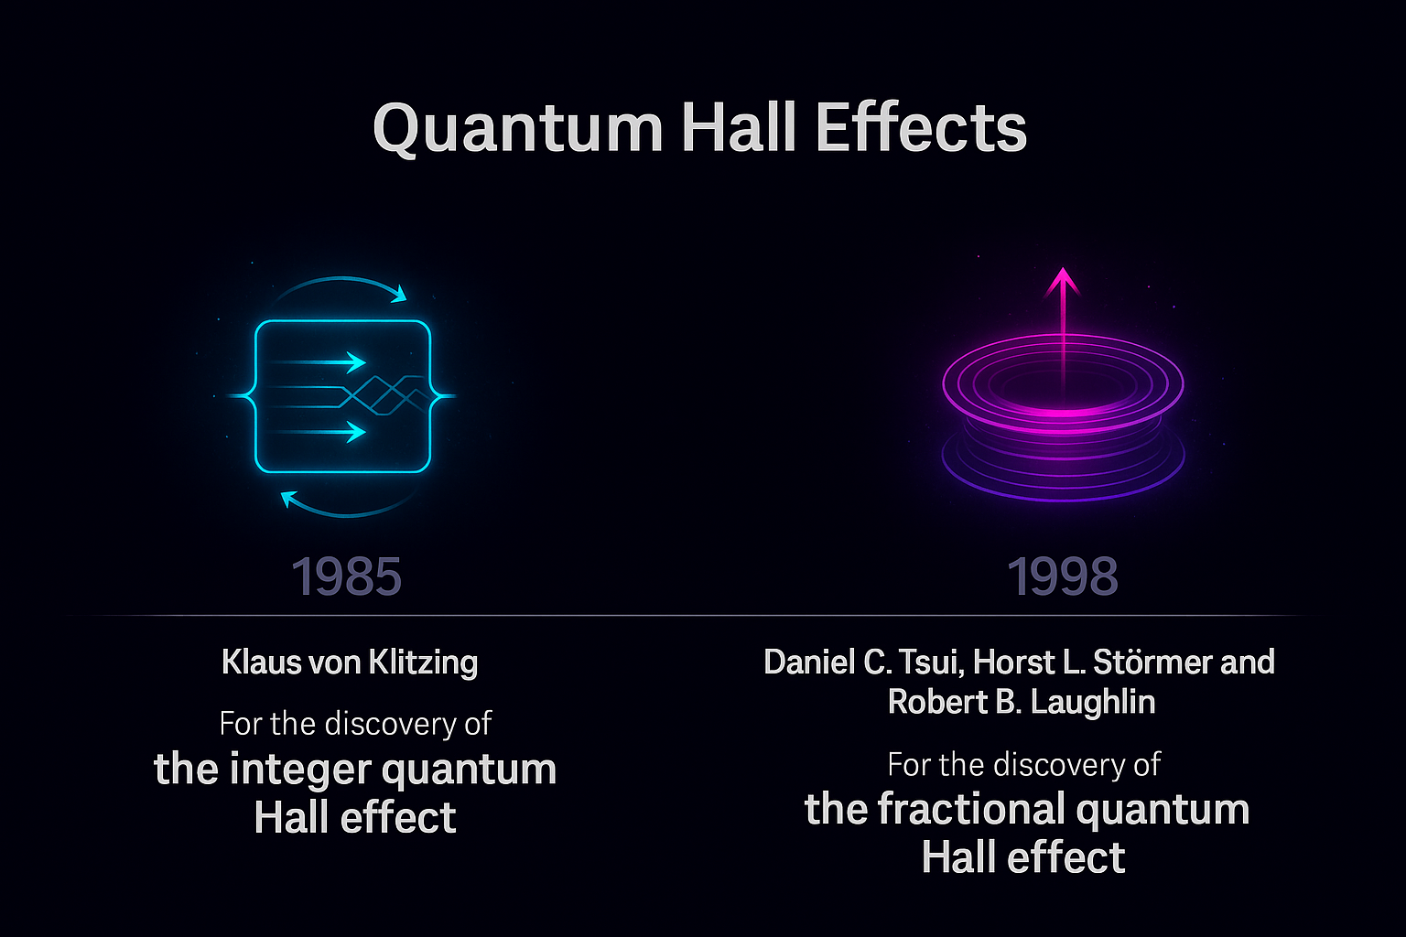
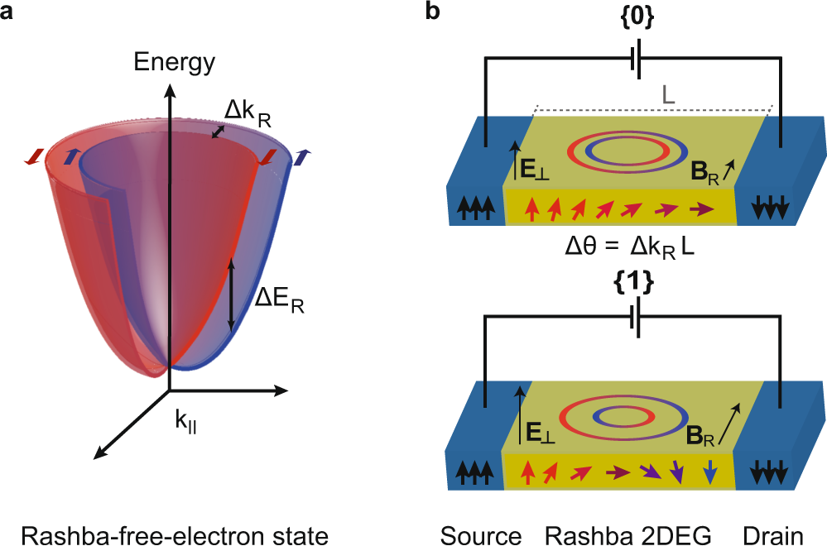
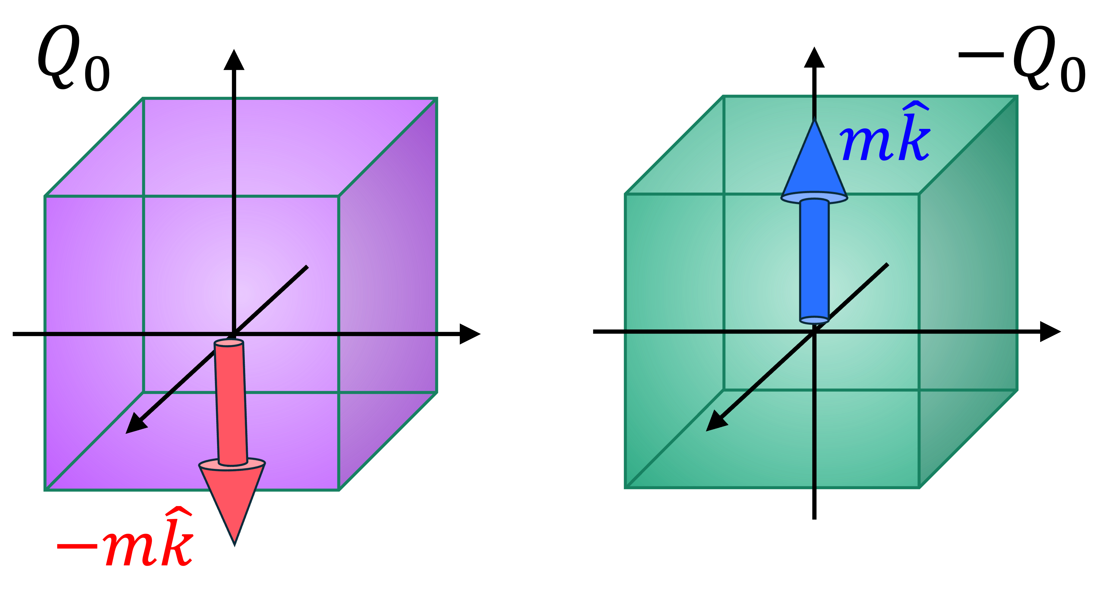
Quantum materials: potential applications
Magnetoelectric
Adv. Mater. 35 2107839 (2021)

Slide 4
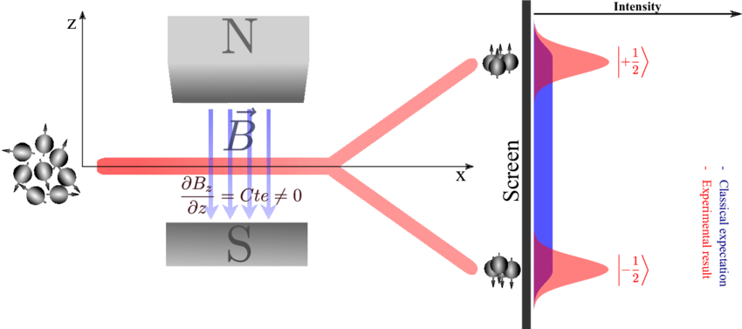
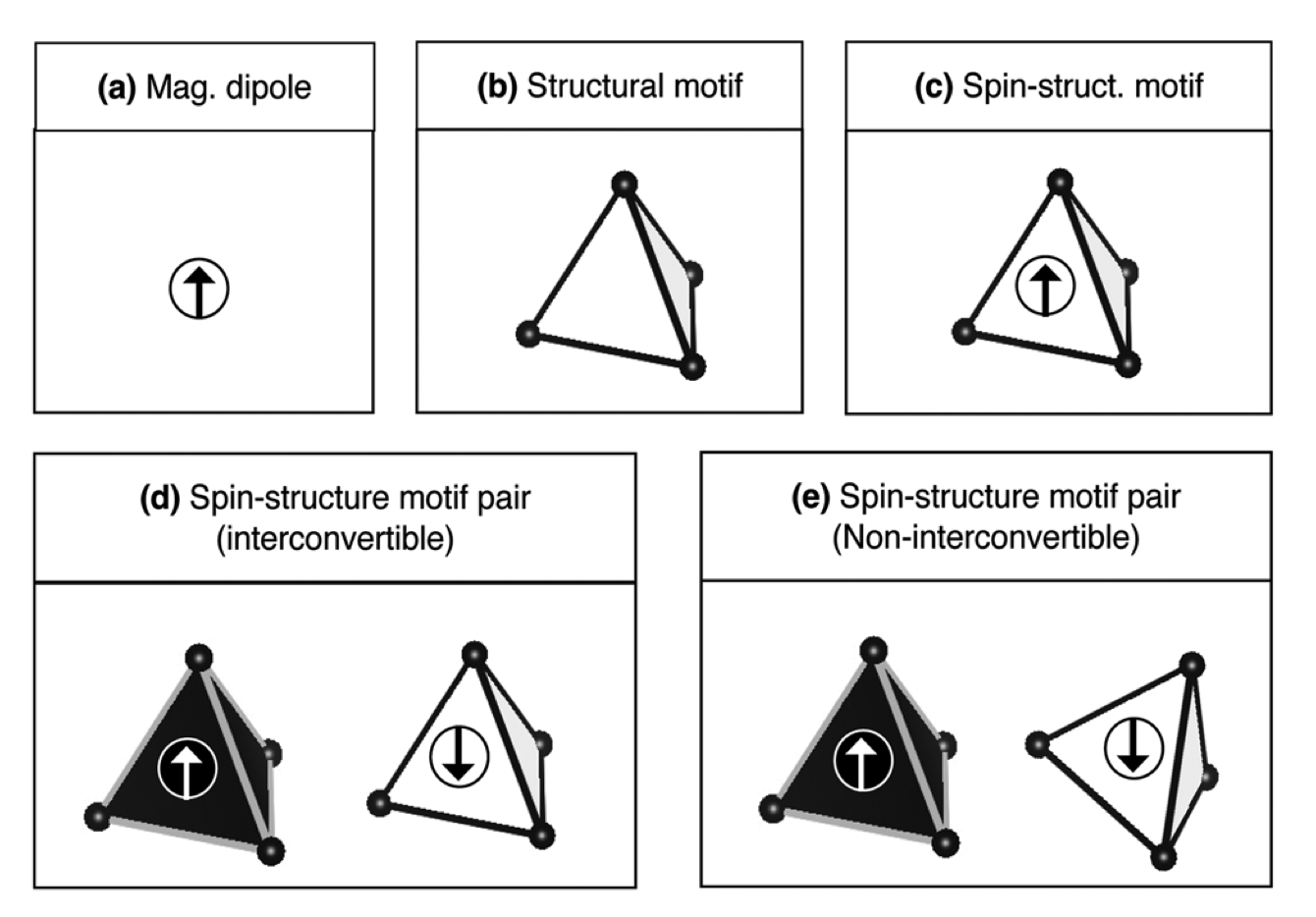
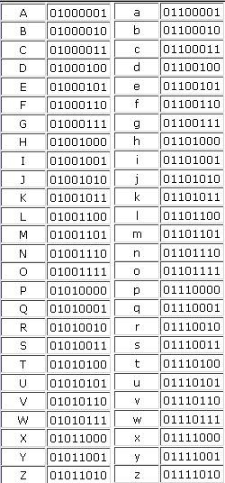
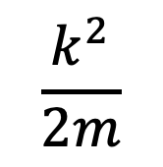
A single motif: The Zeeman effect as a model
$$\frac{k^{2}}{2m}$$
Energy
Momentum k

Slide 5
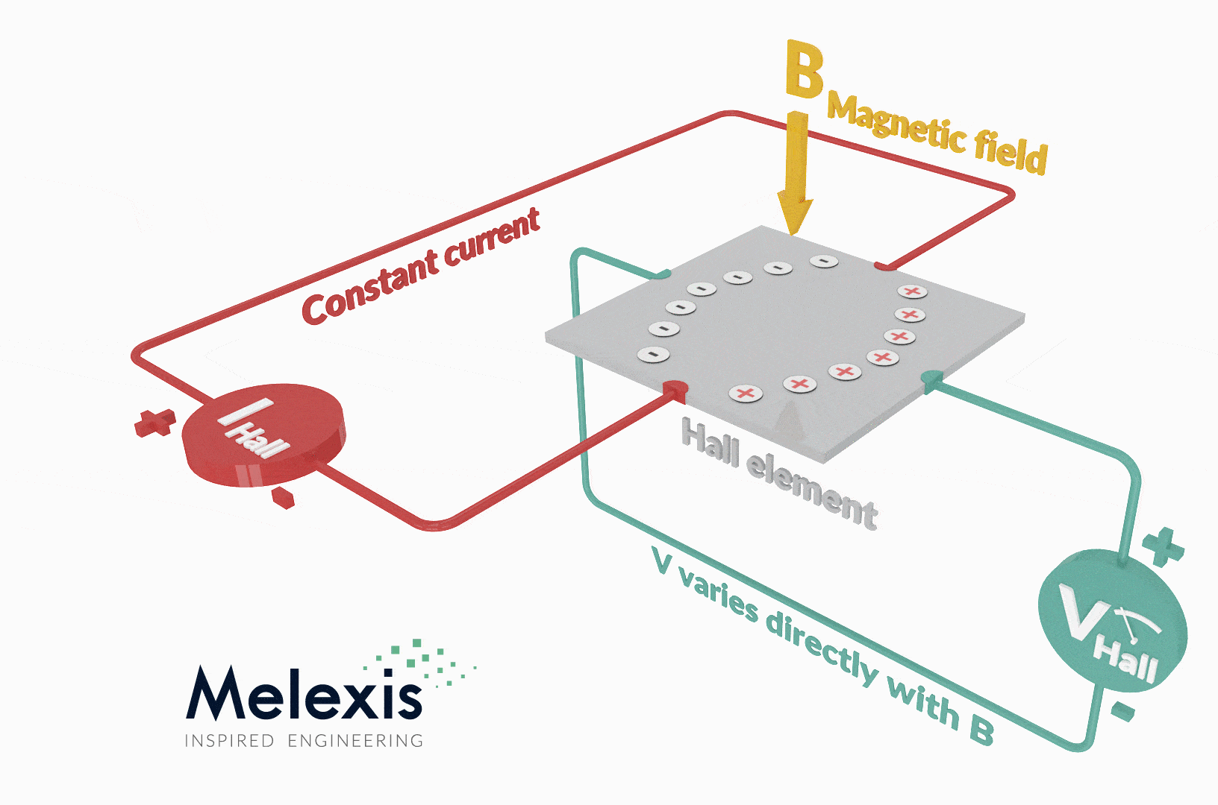
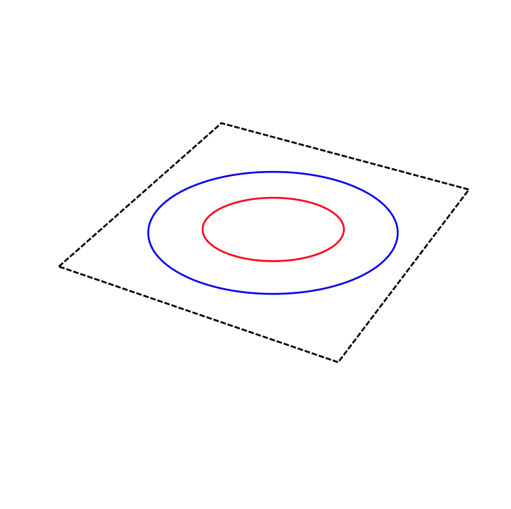
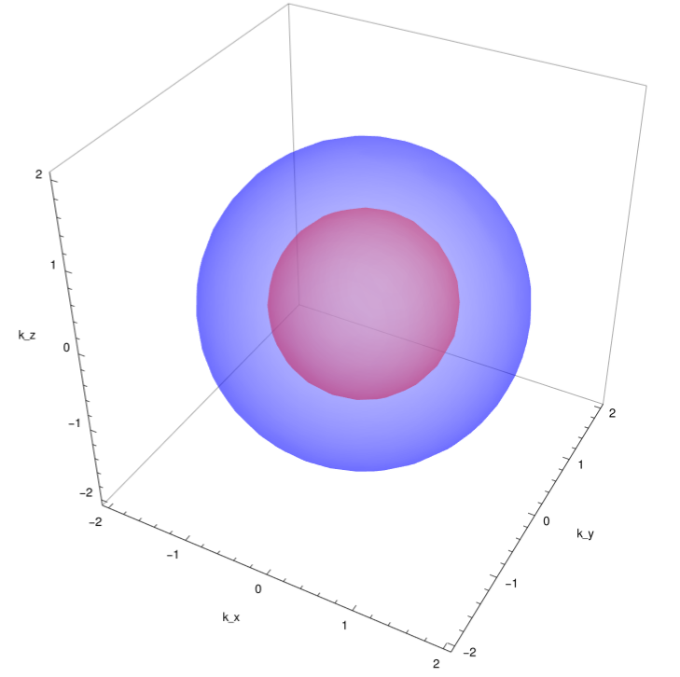
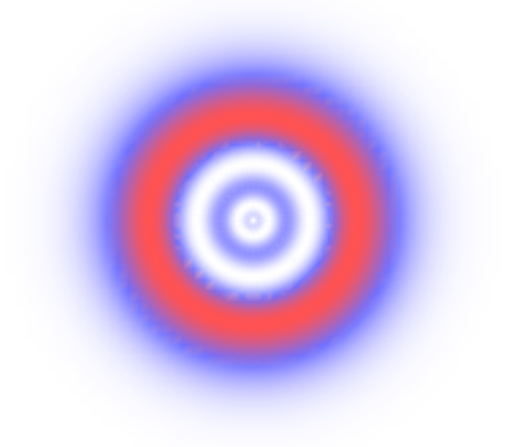
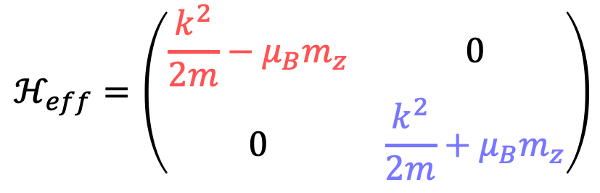
A single motif: The Zeeman effect as a model
$$ℋ_{eff}=\left(\begin{matrix}\frac{k^{2}}{2m}−μ_{B}m_{z} & 0 \\ 0 & \frac{k^{2}}{2m}+μ_{B}m_{z}\end{matrix}\right)$$
k_{y}
Energy
k_{x}
Momentum k
k_{y}
s-wave magnetism
s-orbital

Slide 6
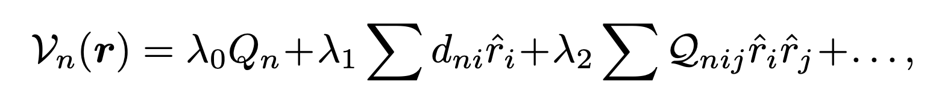
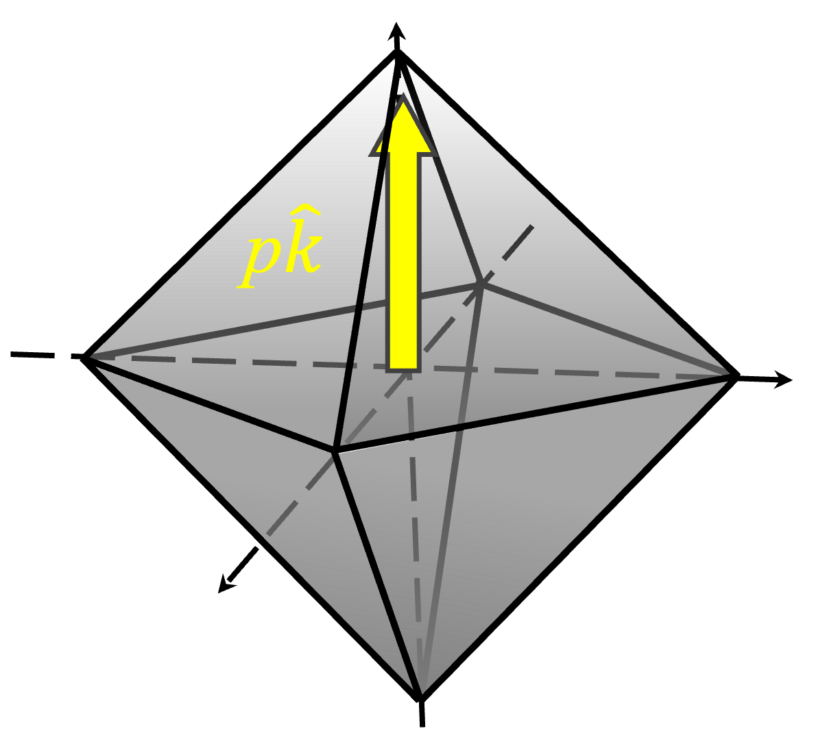
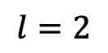
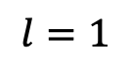
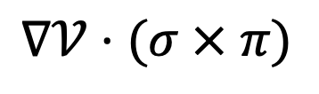
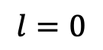
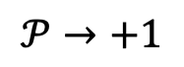
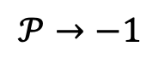
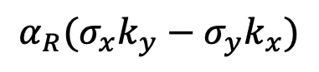
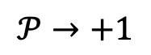
One single electric motif: The Spin-orbit coupling
$$α_{R}(σ_{x}k_{y}−σ_{y}k_{x})$$
E_{R}
$$l=0$$
$$l=1$$
$$l=2$$
+
+
-
+
k_{y}
k_{R}
-
-
+
k_{x}
$$𝒫→+1$$
$$𝒫→−1$$
$$𝒫→+1$$
Energy
Centrosymetric
Polar
Non-Polar
$$∇𝒱⋅(σ × π)$$
Momentum k
D

Slide 7
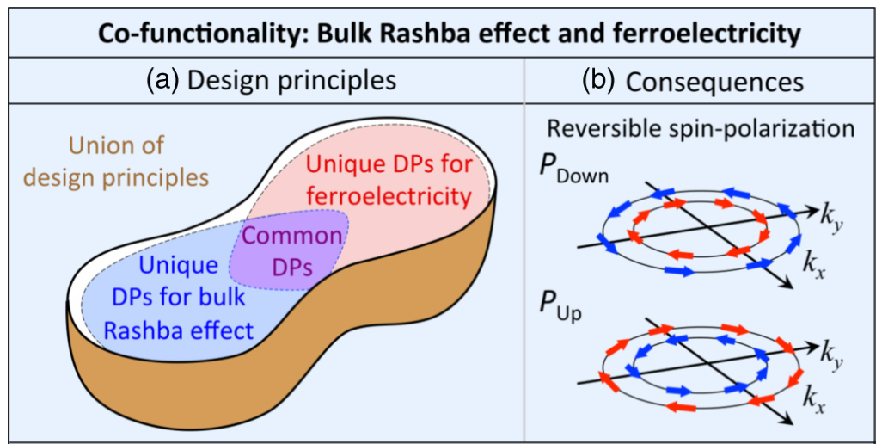
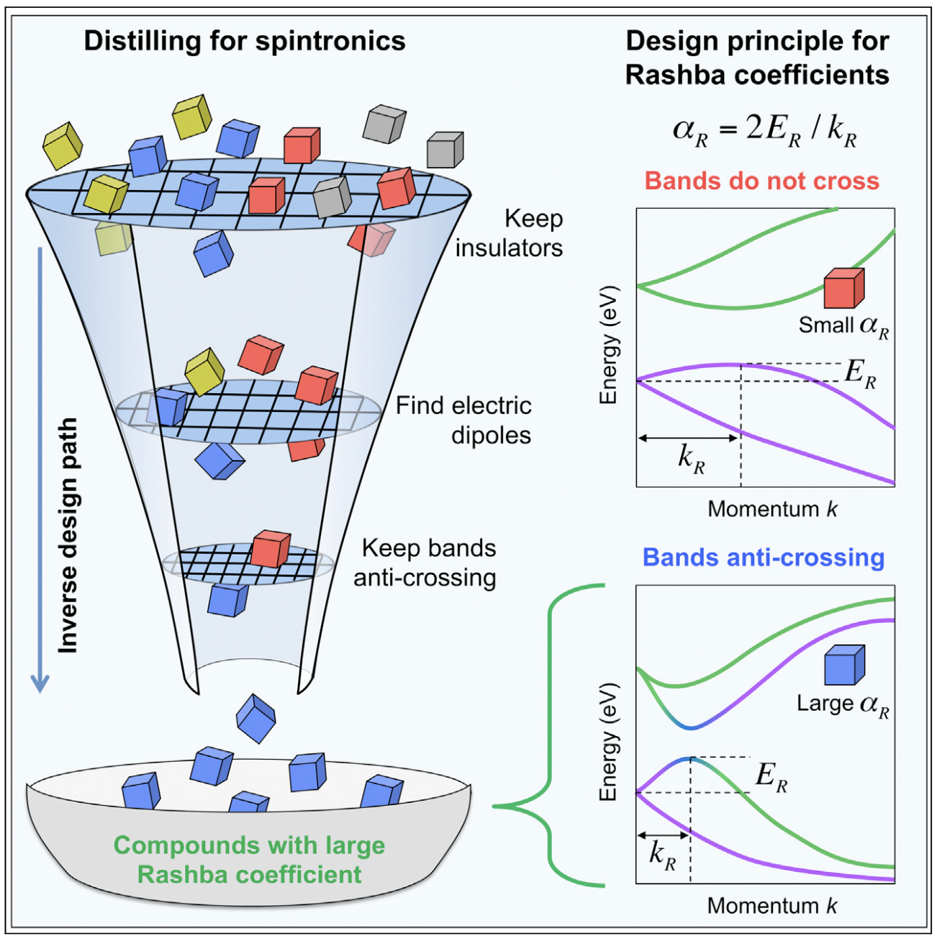
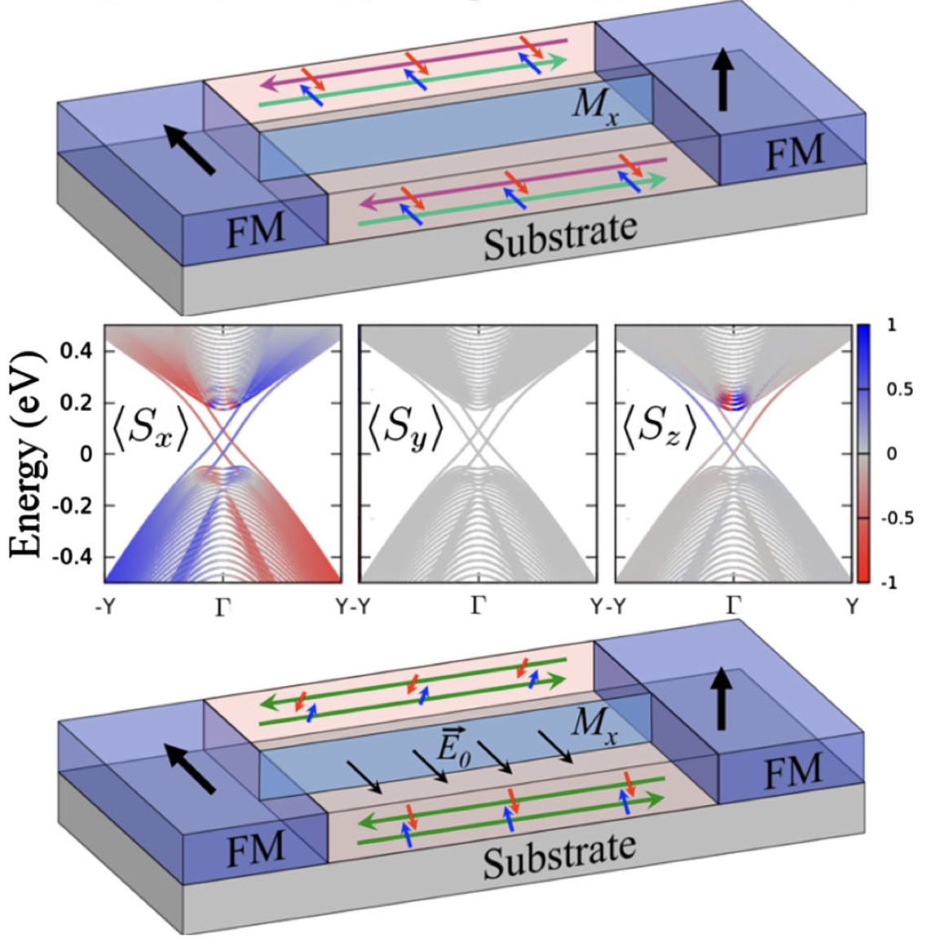
Some implications of the SOC: The Rashba effect
$$α_{R}(σ_{x}k_{y}−σ_{y}k_{x})$$
CMA and Fazzio. PRL 122, 036401 (2019)
Energy
E
P_{Down}
0
P_{Up}
ξ₀
7
Momentum k
CMA, Fazzio, Dalpian, Zunger. PRB 102 144106 (2020)
CMA, Ogoshi, Fazzio, Dalpian, Zunger. Matter 3 145 (2020)

Slide 8
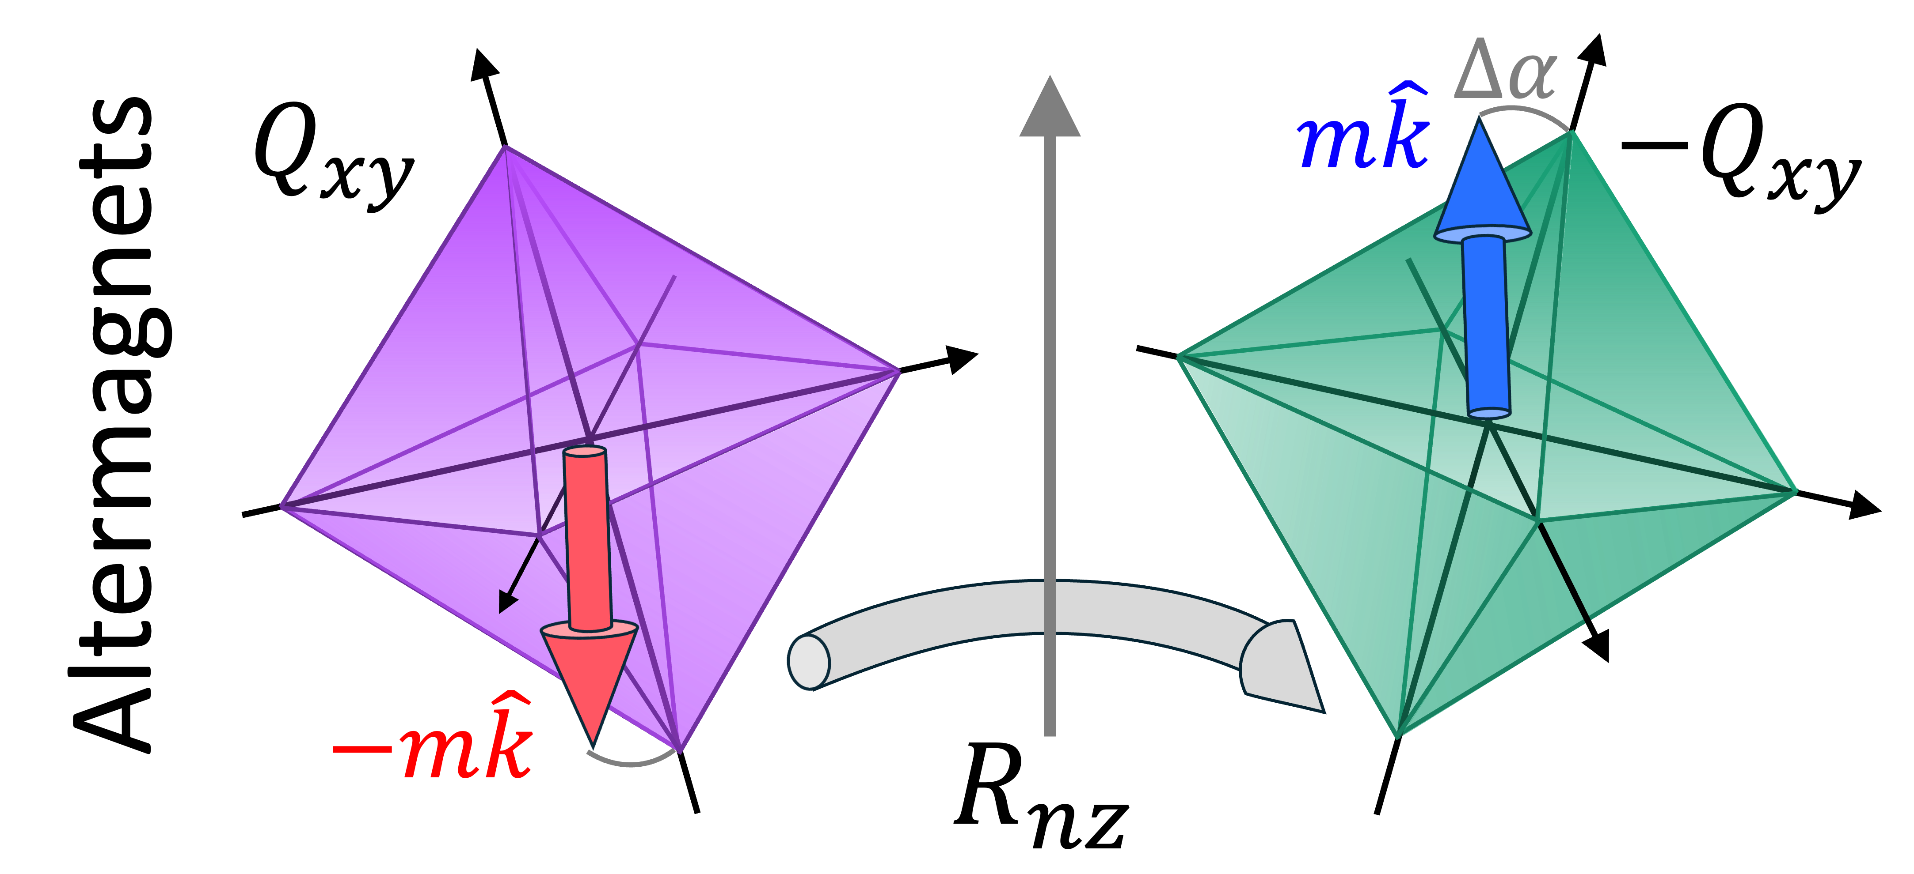
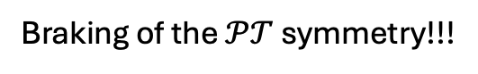
Two magnetic motifs: The traditional model
?
Braking of the $𝒫𝒯$ symmetry!!!
Non-relativistic Spin Splitting (no spin-orbit coupling)
Japan
Boulder - USA
Czech Republic
Energy
J Phy. Soc. Jpn 88 2019 (Kusunose, Yanagi, Hayami)
Energy
PRB 102 014422 2020 (Linding , Alex Zunger and Rashba)
PRX 12 031042 2022 (Libor, Sinova, Jungwith)
“Altermagnets” and relation with a “fancy notation”
Symmetry rules and characterization
Electronic structure Description
Momentum k
Momentum k
Momentum k

Slide 9
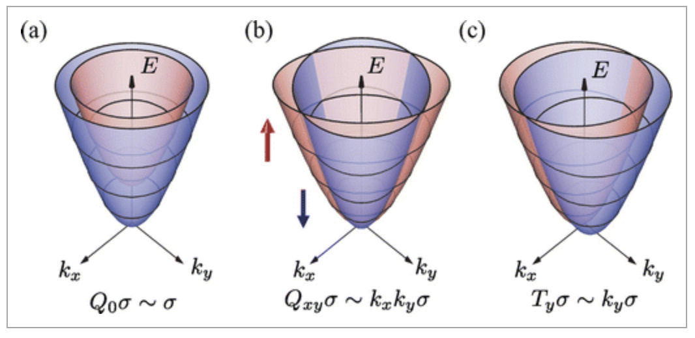
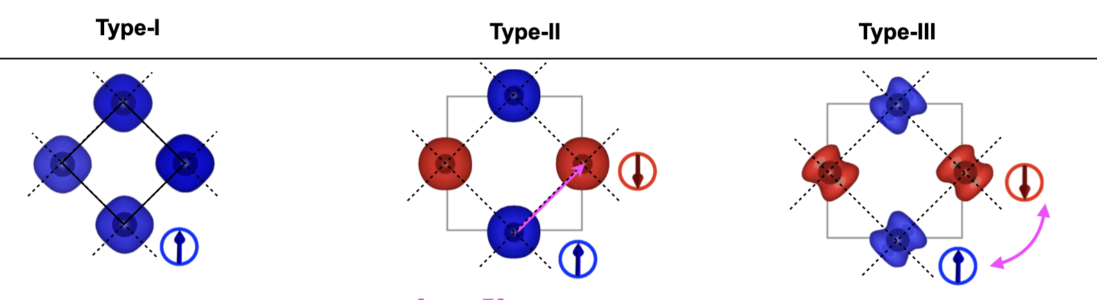
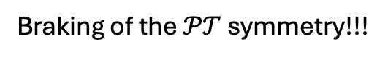
Altermagnets: a new chapter in the magnetic materials
Japan
J Phy. Soc. Jpn 88 2019 (Kusunose, Yanagi, Hayami)
Symmetry rules and characterization
Czech Republic
PRX 12 031042 2022 (Libor, Sinova, Jungwith)
“Altermagnets” and relation with a “fancy notation”
Braking of the $𝒫𝒯$ symmetry!!!

Slide 10
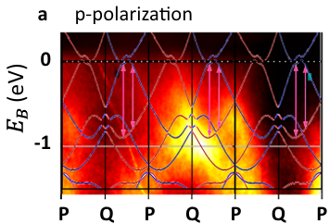
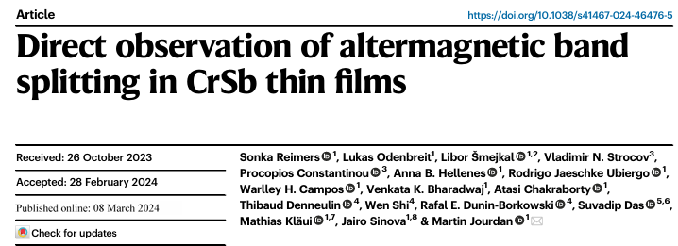
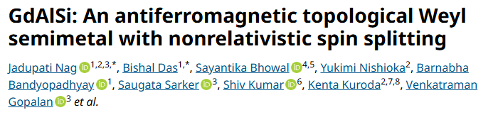
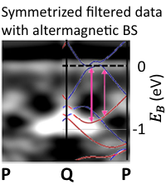
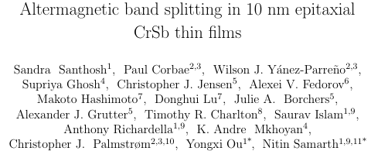
Altermagnetism: Experiments (ARPES)
- The magnetic order description - Temperature - Quantum anomalous Hall

Slide 11
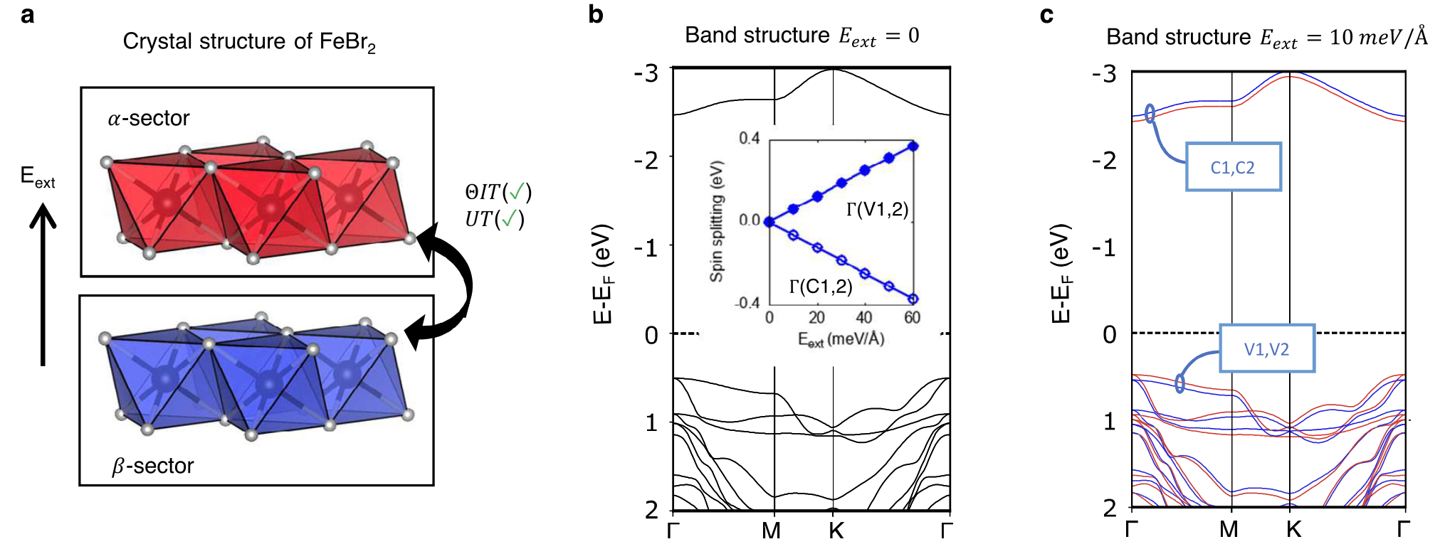
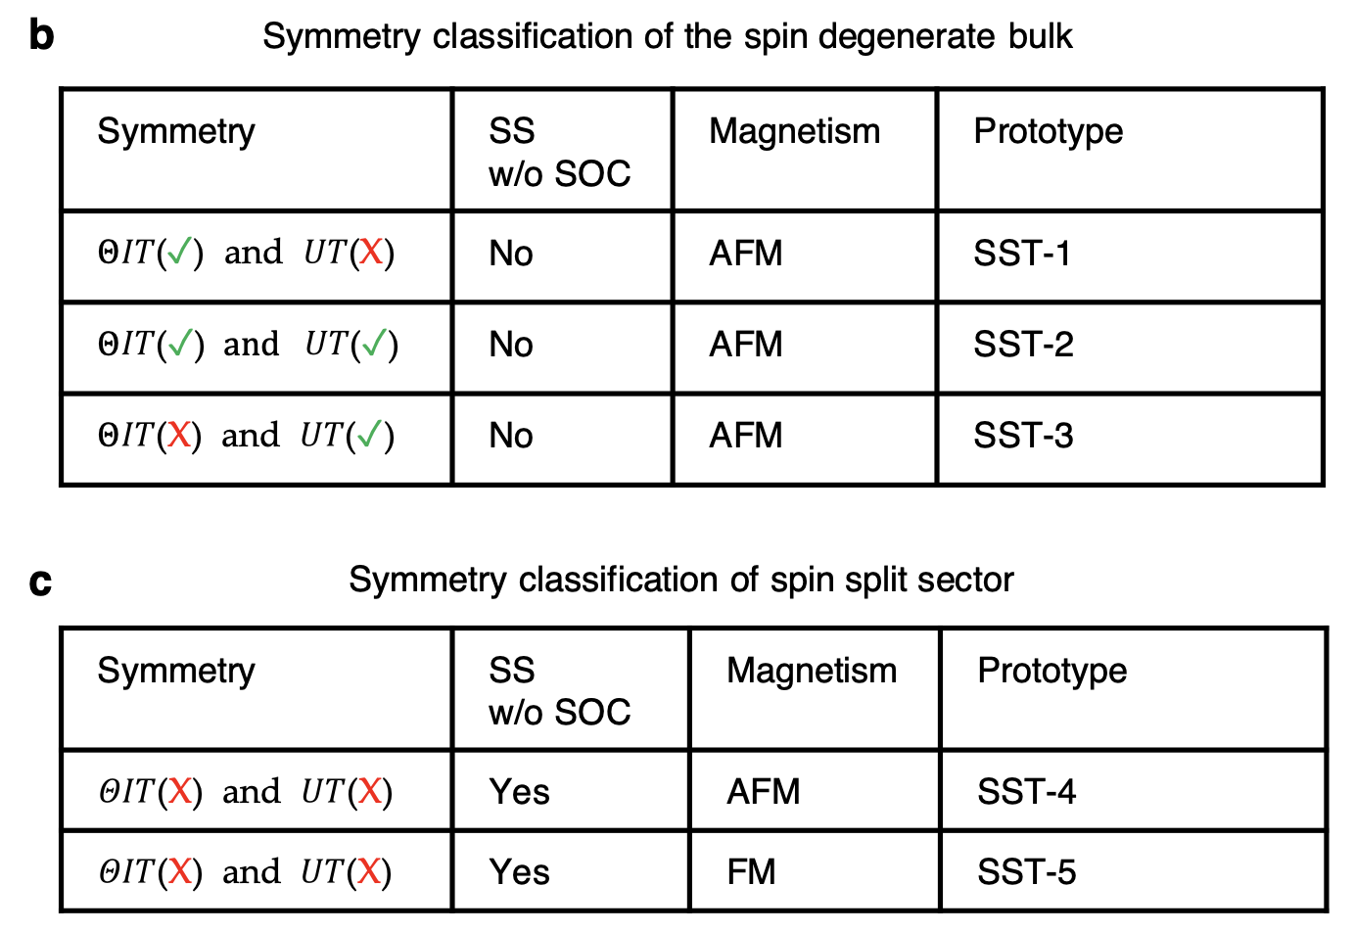
Altermagnetism: No interconnected magnetic motifs
PRM 2021
Yuan, CMA, Zunger. Nature Communication (2023)

Slide 12
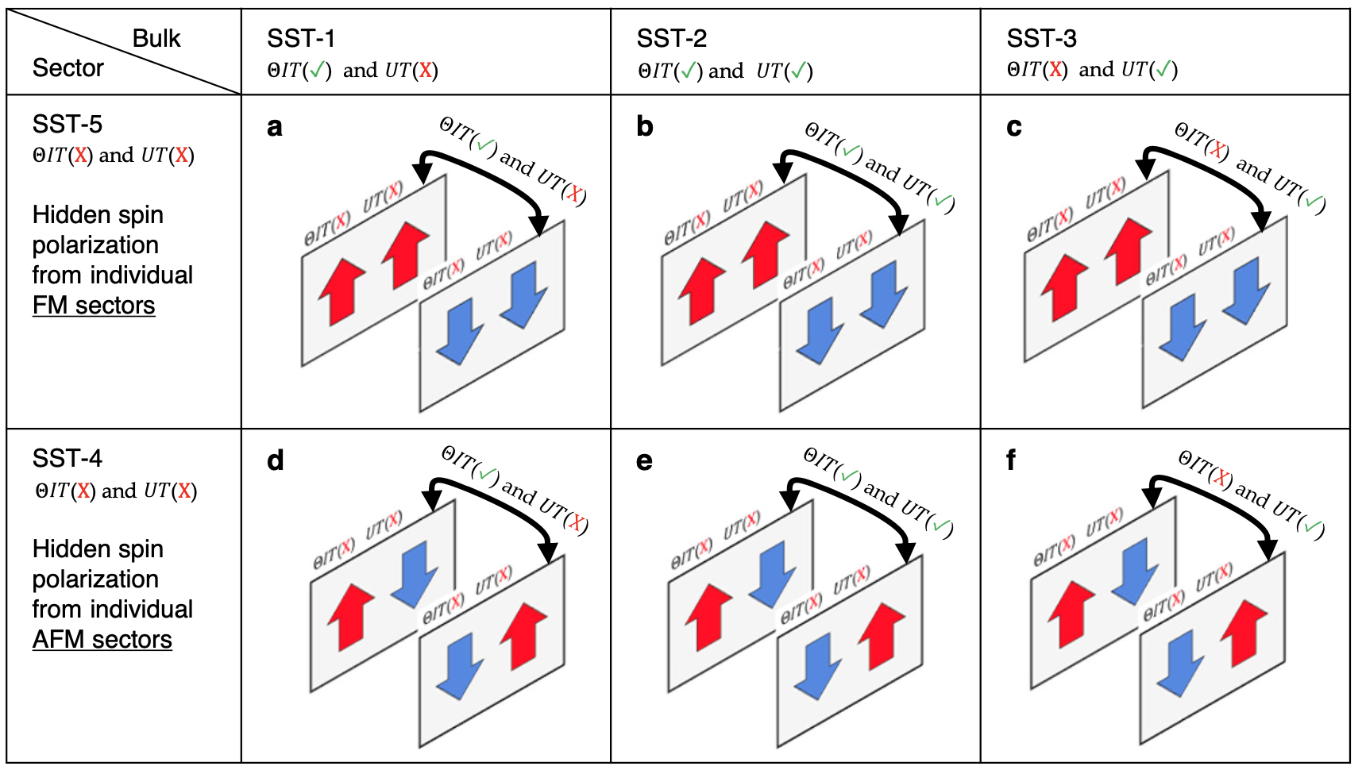
Let´s first focus on the magnetic behavior
Yuan, CMA, Zunger. Nature Communication (2023)

Slide 13
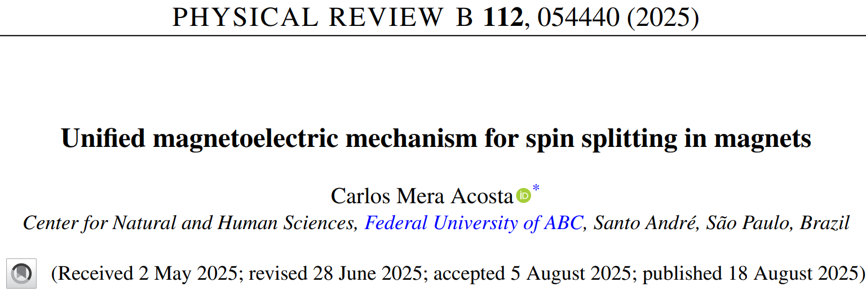
A possible magnetoelectric explanation for the spin splitting
Non-relativistic Spin splitting
Energy
Momentum k

Slide 14
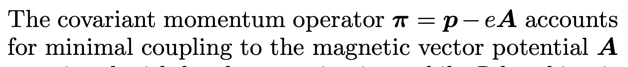
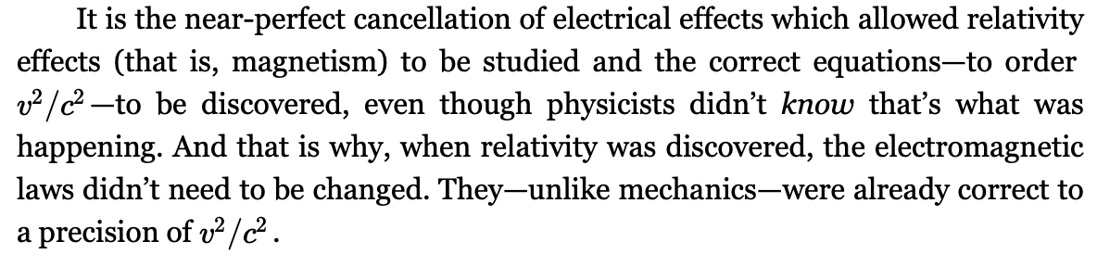
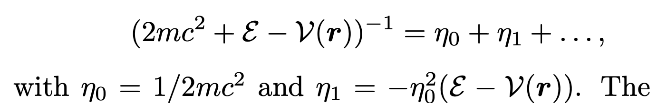




The spin splitting is a magnetoelectric consequence
Let’ s start with the text book’s procedure:
Covariant momentum operator: $π=p−eA$
Non-relativistic corrections:
With and
Feynman Lectures (1963)
CMA Phys. Rev B 112 054440 (2025)

Slide 15



The spin splitting is a magnetoelectric consequence
Let’ s start with the text book’s procedure:
Covariant momentum operator: $π=p−eA$
Non-relativistic corrections:
Not necessarily commute
With and
CMA Physical Review B 112 054440 (2025)

Slide 16


The spin splitting is a magnetoelectric consequence
Let’ s start with the text book’s procedure:
Covariant momentum operator: $π=p−eA$
SOC + Darwing terms
CMA Physical Review B 112 054440 (2025)

Slide 17








The spin splitting is a magnetoelectric consequence: different electric sources
Monopole
$$l=0$$
$$l=1$$
$$l=2$$
+
+
-
Dipole
+
-
-
+
$$𝒫→+1$$
$$𝒫→−1$$
$$𝒫→+1$$
Quadrupole
CMA Physical Review B 112 054440 (2025)

Slide 18





The spin splitting is a magnetoelectric consequence: different electric sources
Monopole
$$ℋ_{eff}=\left(\begin{matrix}\frac{k^{2}}{2m}−μ_{B}m_{z} & 0 \\ 0 & \frac{k^{2}}{2m}+μ_{B}m_{z}\end{matrix}\right)$$
Dipole
s-wave magnetism
s-orbital
$$ℋ_{eff}=\left(\begin{matrix}\frac{k^{2}}{2m}+α k_{x}k_{y} & 0 \\ 0 & \frac{k^{2}}{2m}−α{ k}_{x}k_{y}\end{matrix}\right)$$
Quadrupole
d-wave magnetism
d-orbital

Slide 19




The quadrupole-regime: Altermagnets as magnetoelectric materials
Quadrupole

Slide 20


The quadrupole-regime: Altermagnets as magnetoelectric materials
An example with mirror symmetry:
CMA Physical Review B 112 054440 (2025)

Slide 21




The quadrupole-regime: Altermagnets as magnetoelectric materials
Physical Review B 102 014422 (2020)

Slide 22




The monopolar-regime: spin splitting at Gamma in AFM
Monopole
CMA Physical Review B 102 014422 (2020)

Slide 23






















The dipolar-regime - Mirrormagnets (description and enabling conditions)
(Polar CPGS without magnetoelectric SS
Mirror symmetry
Polar CPGS with magnetoelectric SS
$$p_{z}$$
$$p_{z}$$
$$p_{z}$$
$$p_{z}$$
$${−p}_{x}$$
$$p_{x}$$
y
y
y
y
$$−m\hat{k}$$
$$−m\hat{k}$$
$$m\hat{k}$$
$$m\hat{k}$$
$$ℳ_{y}$$
x
$$ℳ_{y}$$
x
x
x
$$𝒱_{1}\left(r\right)$$
$$ℳ 𝒱_{1}\left(r\right){ ℳ}^{†}$$
$$ℋ_{p}=−μ_{B}η_{0}λ_{1}$$
$$σ_{z}m$$
$$\left[p_{z}−p_{z}\right]k_{z}$$
$$ℋ_{p}=−μ_{B}η_{0}λ_{1}$$
$$σ_{z}m$$
$$\left(\left[p_{z}−p_{z}\right]k_{z}+\left[{(−p}_{x})−p_{x}\right]k_{x}\right)$$
$$ℋ_{ME}=−μ_{B}η_{0}\left(𝒱_{1}−𝒱_{2}\right)σ∙m$$
$$ℋ_{p}=0$$
$ℋ_{p}={2μ}_{B}η_{0}λ_{1}σ_{z}m$ $p_{x} k_{x}$
Under review…

Slide 24

















Minimal four-band model for polar mirrormagnets
$$ℋ_{ME}=(p_{x}k_{x}+p_{z}k_{z})(σ_{z}m)$$
$$ℋ_{ME}=({−p}_{x}k_{x}+p_{z}k_{z})({−σ}_{z}m)$$
$$p_{z}$$
$$p_{z}$$
$$τ_{0}=\left(\begin{matrix}1 & 0 \\ 0 & 1\end{matrix}\right)$$
$$p_{x}$$
$${−p}_{x}$$
$$σ_{z}=\left(\begin{matrix}1 & 0 \\ 0 & −1\end{matrix}\right)$$
y
y
$$m\hat{k}$$
$$−m\hat{k}$$
x
$$ℳ_{y}$$
x
$$ℋ_{p}=\frac{k^{2}}{2m}\left(\begin{matrix}\begin{matrix}1 & 0 \\ 0 & 1\end{matrix} & \begin{matrix}0 & 0 \\ 0 & 0\end{matrix} \\ \begin{matrix}0 & 0 \\ 0 & 0\end{matrix} & \begin{matrix}1 & 0 \\ 0 & 1\end{matrix}\end{matrix}\right)$$
$${+p}_{x}\left(\begin{matrix}\begin{matrix}k_{x} & 0 \\ 0 & {−k}_{x}\end{matrix} & \begin{matrix}0 & 0 \\ 0 & 0\end{matrix} \\ \begin{matrix}0 & 0 \\ 0 & 0\end{matrix} & \begin{matrix}k_{x} & 0 \\ 0 & {−k}_{x}\end{matrix}\end{matrix}\right)$$
$${+p}_{z}\left(\begin{matrix}\begin{matrix}k_{z} & 0 \\ 0 & {−k}_{z}\end{matrix} & \begin{matrix}0 & 0 \\ 0 & 0\end{matrix} \\ \begin{matrix}0 & 0 \\ 0 & 0\end{matrix} & \begin{matrix}{−k}_{z} & 0 \\ 0 & k_{z}\end{matrix}\end{matrix}\right)$$
$ℋ_{p}=\frac{k^{2}}{2m}{(τ}_{0}⨂ σ_{0})+p_{x}k_{x} {(τ}_{0}⨂$ $σ_{z})+p_{z}k_{z}{(τ}_{z}⨂ σ_{z})$

Slide 25






An application for Nb₂Mn₄O₉: The Hall conductivity
Under review…

Slide 26
P-wave magnetism mediated by mirror symmetries: mirrormagnets
Under review…

Slide 27









Description of the non-collinear magnetoelectric coupling
Monopole
Dipole
Quadrupole
$$d_{j}$$
Dipole
Moment
magnetic
Submitted…
CMA Physical Review B 112 054440 (2025)

Slide 28








Magnetoelectric coupling produce Weyl and Rashba spin textures
Weyl
$$R=S_{R}\left(σ_{x}k_{y}−σ_{y}k_{x}\right)\hat{z}$$
$$D=S_{R}(σ_{x}k_{x}−σ_{y}k_{y})$$
$$W=S_{W}(σ_{x}k_{x}+σ_{y}k_{y})$$
Quadrupole
Submitted…
CMA Physical Review B 112 054440 (2025)

Slide 29
Take home messages...
There are infinite ways to combine building blocks to construct “novel” phenomena — so it is likely that many others remain to be predicted.
In magnetic materials, history took a different turn: the theory once used to explain them was not entirely correct, yet nobody noticed it before.
The magnetoelectric coupling can explain all the observed spin splitting. Applications are still an open questions.
The prediction of novel quantum materials through machine learning and other emerging tools (e.g., inverse design) is an open and exciting avenue in the AI era.
mera.acosta@ufabc.edu.br

Slide 30



Yuri
Aoto
Mauricio D.
Coutinho Neto
Ronei
Miotto
Romarly da
Costa
Thiago
Branquinho
Rodrigo
Cordeiro
Paula Homem
de Mello
Carlos Mera
Acosta
Pedro
Autreto
João Nuno
Rodrigues
Káthia
Honório (USP)
Vitor Hugo
Paschoal
James
Almeida (ILUM)
Cedric
Rocha
Jeverson
Arantes

Slide 31














Acknowledgments
mera.acosta@ufabc.edu.br
Gustavo Dalpian IFUSP
Adalberto Fazzio
Ilum-CNPEM
James de Almeida Ilum-CNPEM
Pedro Autetro UFABC
Felipe Crasto
Ilum CNPEM
Roberto Hiroki
UFU
Reynel Cardenas, Valeria Quintana, and David Cuello
Oleksandr Maly Ensemble CE
Alex Zunger CU Boulder
Linding Yuan
Northwester U
José Souza UFABC
Paula de Melo UFABC

